Slide 1
Mobile Sales Dashboard
Task 8 - Data Analyst Internship
Sujata Kulkarni

Slide 2

Mobile Phones: The Heartbeat of Modern Life
Mobile phones have evolved far beyond mere communication devices they are now essential tools shaping our daily lives. From staying connected with loved ones to managing businesses, education, and entertainment, smartphones have seamlessly integrated into every aspect of human interaction.
This dashboard is designed to provide valuable mobile insights, showcasing trends in sales performance, customer behavior and product preferences

Slide 3
Dashboard Overview
Purpose: Provide insights on sales trends, Customer behavior, and product preferences. Sections: Insights Product View Customer View
Key Metrics:
Revenue: $1.14M (10%↑ from last month)
Quantity: 1.65K (7%↑ from last month)
Total Orders: 31
Average Price: $691

Slide 4
Sales Analysis Overview
Top Brands Performance
Brands: Apple, Google, OnePlus, Samsung, Xiaomi
Metrics:
Revenue by Month
Quantity by Month
Top Models:
iPhone 15 Pro, iPhone 15, OnePlus Nord, etc.

Slide 5
Customer Insights & Geographical Insights
Revenue by Age Group:
18-25: $2.6M
26-33: $3.3M
34-41: $2.2M
Revenue by Gender:
Female: $1.21M
Male: $7.20M
Payment Preferences:
Credit Card, UPI, EMI, Cash
Map Visual: Highlight key markets (India, USA, Europe, etc.)
Revenue by Country: List top countries with figures.

Slide 6
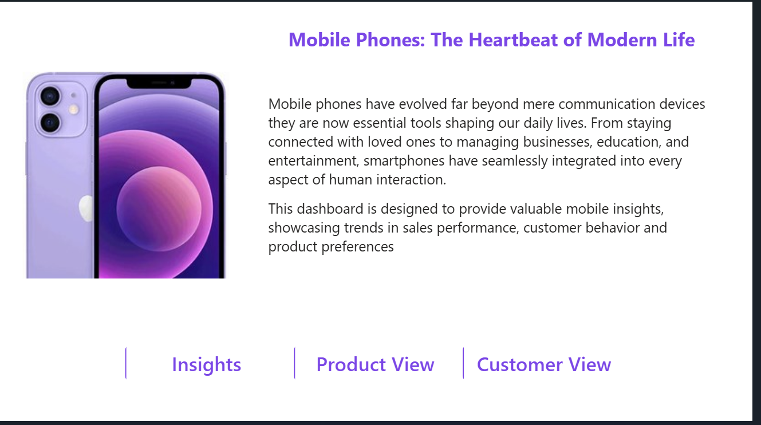

Slide 7
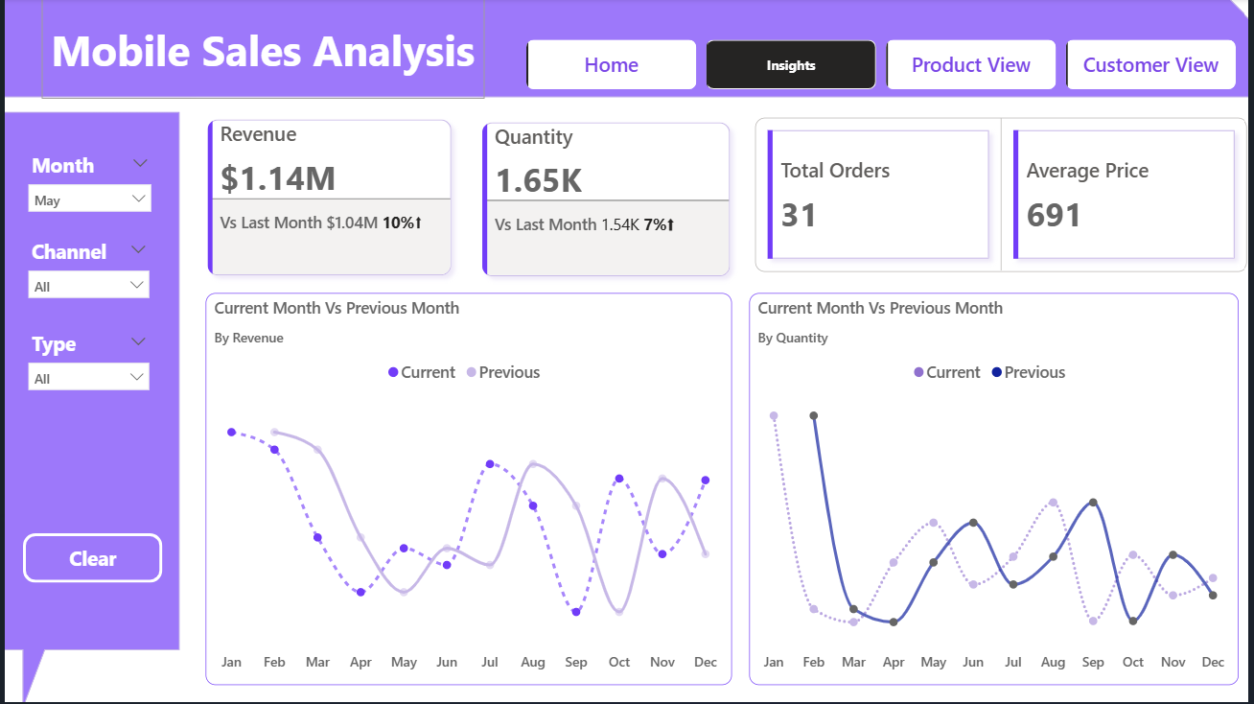

Slide 8
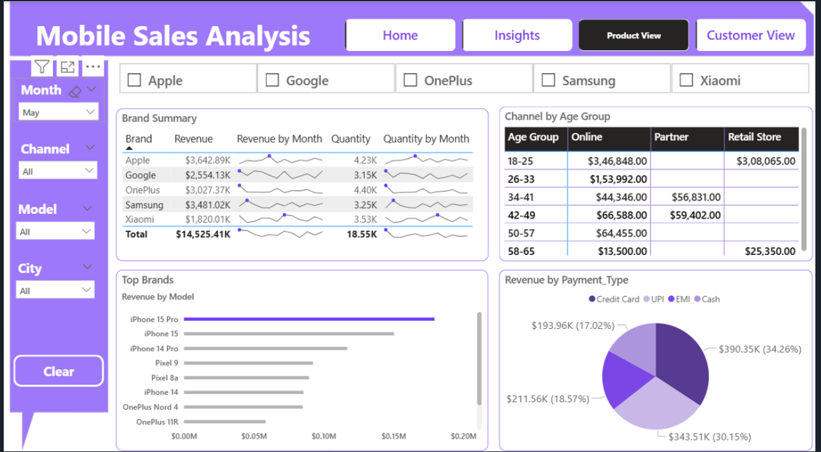

Slide 9
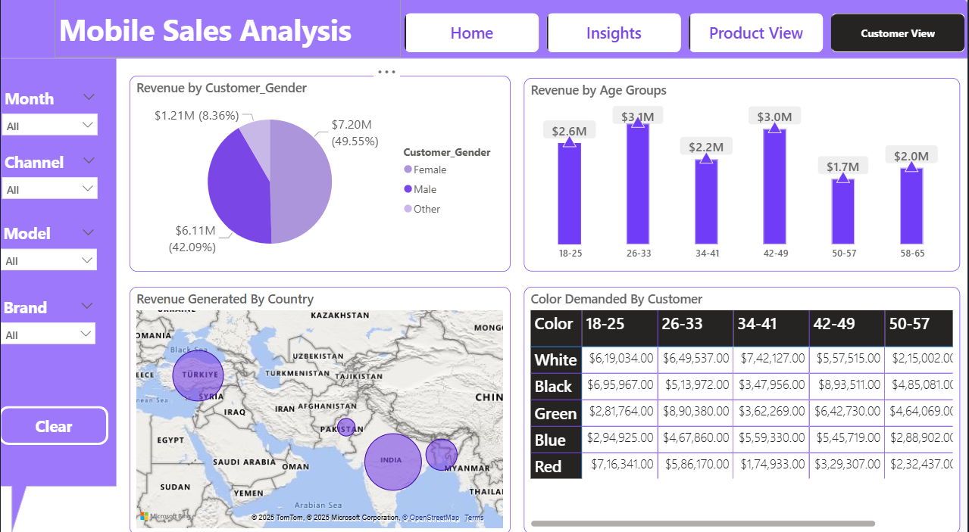

Slide 10
Conclusion
Key Takeaways:
Rising sales in key age groups (18-25, 26-33).
Male customers drive higher revenue.
Credit Card and UPI dominate payments.
Apple leads in revenue.

